Slide 1
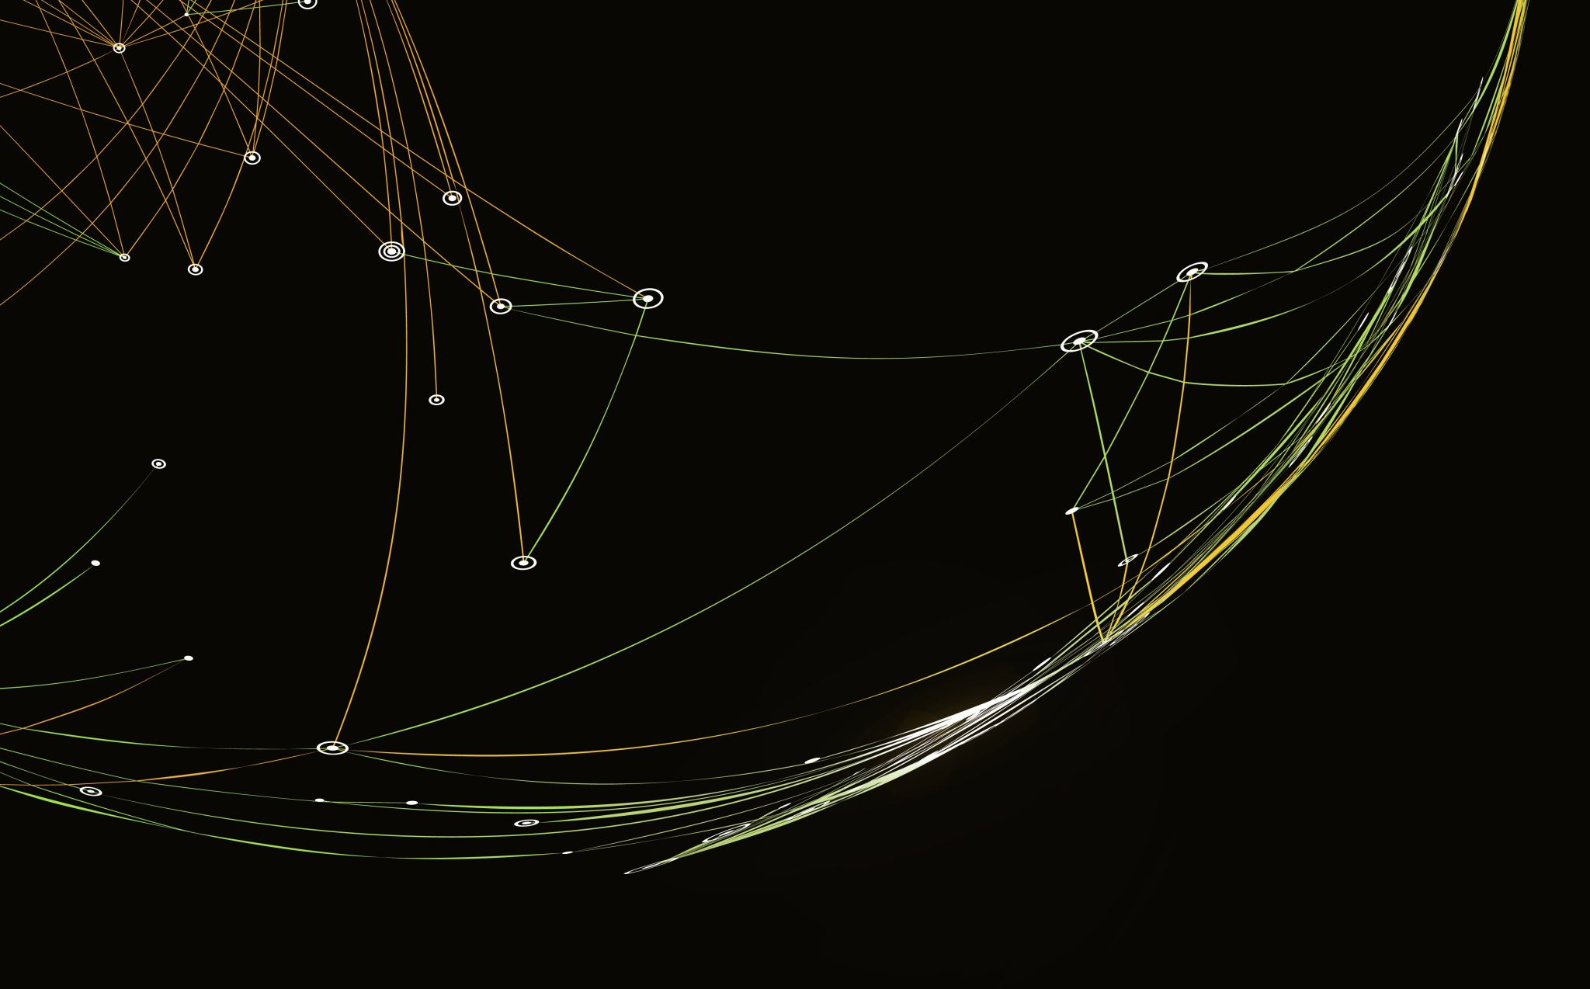

Volatility Prediction in Stock Exchange
By Adari Lohit Abhinav Thupili Kai Li

Slide 2

INTRODUCTION
The stock market is unpredictable and constantly fluctuating, presenting a challenging yet potentially rewarding investment opportunity.
Volatility prediction is a tool that uses past data to forecast market trends and changes in price fluctuations, providing essential indicators for trading strategies and risk management.
Statistical models such as HMM and GARCH can be used to forecast volatility in the stock exchange, with effectiveness evaluated through performance metrics like MAE and RMSE.

Slide 3
OBJECTIVES
To find the volatility of European stocks over time and identify the RMSE values. To estimate how close the actual and predicted plots look using statistical tools.
And to find the residuals of actual and predicted values of the stocks.

Slide 4
TECHNOLOGICAL REQUIREMENTS
Software Used: R studio version 4.2.3
System requirements: WIN 10,11 or MacOS, at least 4GB RAM.
Packages Used: RHmm, ggplot2, reshape2, Rugarch
Programming Skills: Data structure, Transforming Data, For-loops.

Slide 5
PROPOSED TECHNIQUES
Framework:
We will experiment with 4 different Stock Exchange time series data sets from each stock exchange, the index values for 500 days after Jan 2009. Each data set is trained on 500 instances, and the forecast is taken cumulatively for the next five values.
Techniques:
The technique we’re going to use is to state probabilities. Present which point belongs to which Marco regime. And will be finding the relative distance between actual and forecasted values, which the RMSE value on the plot can quantitatively represent.
The residuals of the data are plotted along with forecasted residuals of the data to compare the relative distance, presented as RMSE value on the plot.

Slide 6
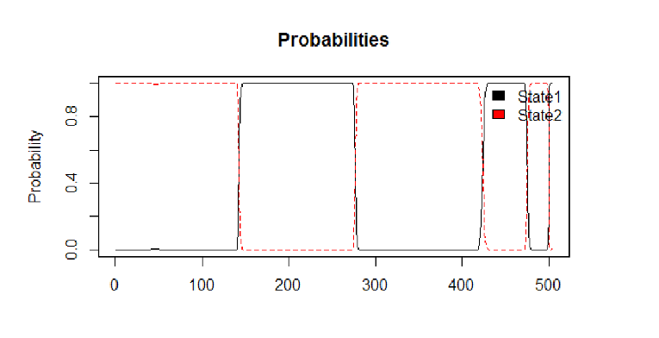
ANALYSIS

Slide 7
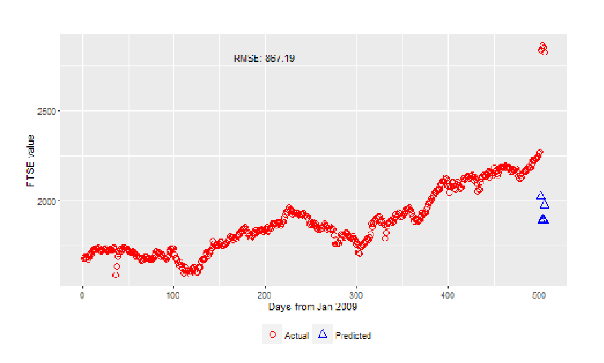
ANALYSIS

Slide 8
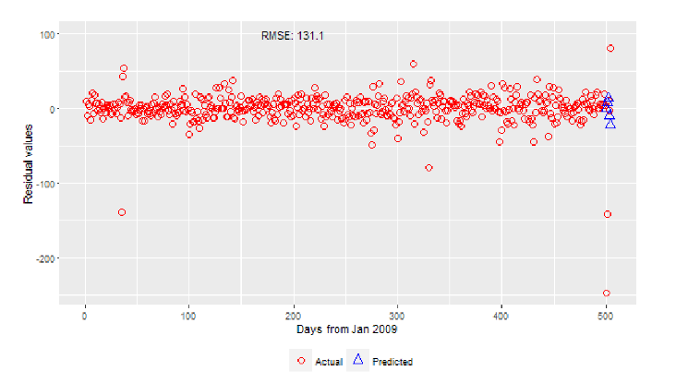
ANALYSIS

Slide 9
CONCLUSION
The MRS-GARCH implementation explained in the report has experimented on different datasets with volatile time series. Forecasts for all the data sets from the MRS-GARCH model show promising results with considerable RMSE values. Hence, we conclude that this model works effectively for volatile time-series datasets.

